Slide 1

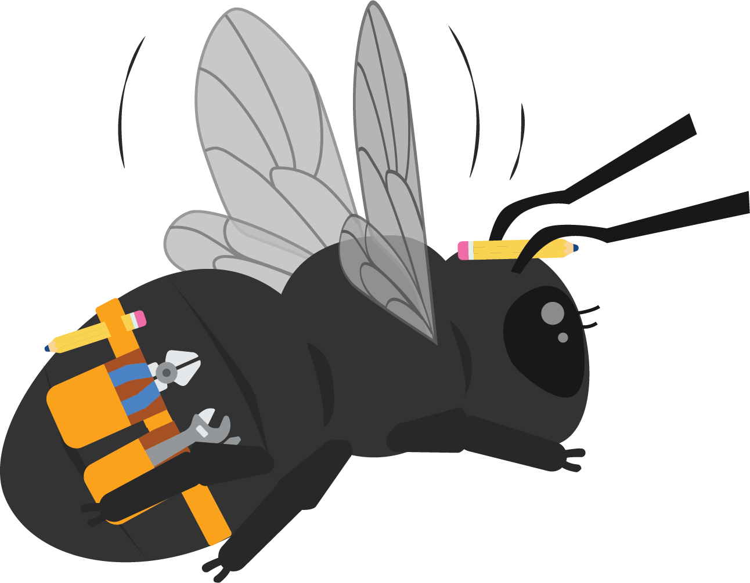
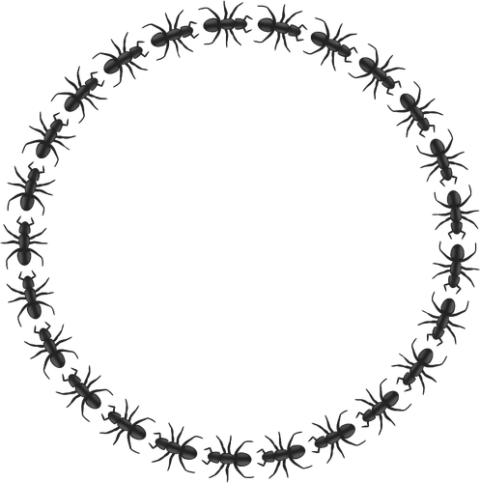

Albert
Ant-stein
Unit 2

Slide 2
Driving Question
Do ants have parts?
Notes:
The driving question you pose to students in order to get them to investigate a problem.

Slide 3
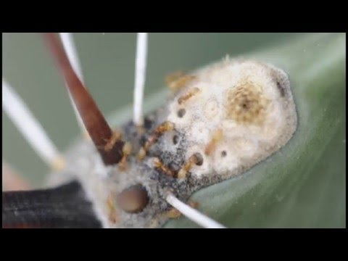
Phenomena
Let’s watch the video and revisit our wonder wall.
Did we answer any of our wonders?
Do we have any new wonders?
Notes:
Wonderwall - Show the ant video from the slide deck and ask students what they notice and what they wonder about. Revisit the Wonderwall.

Slide 4
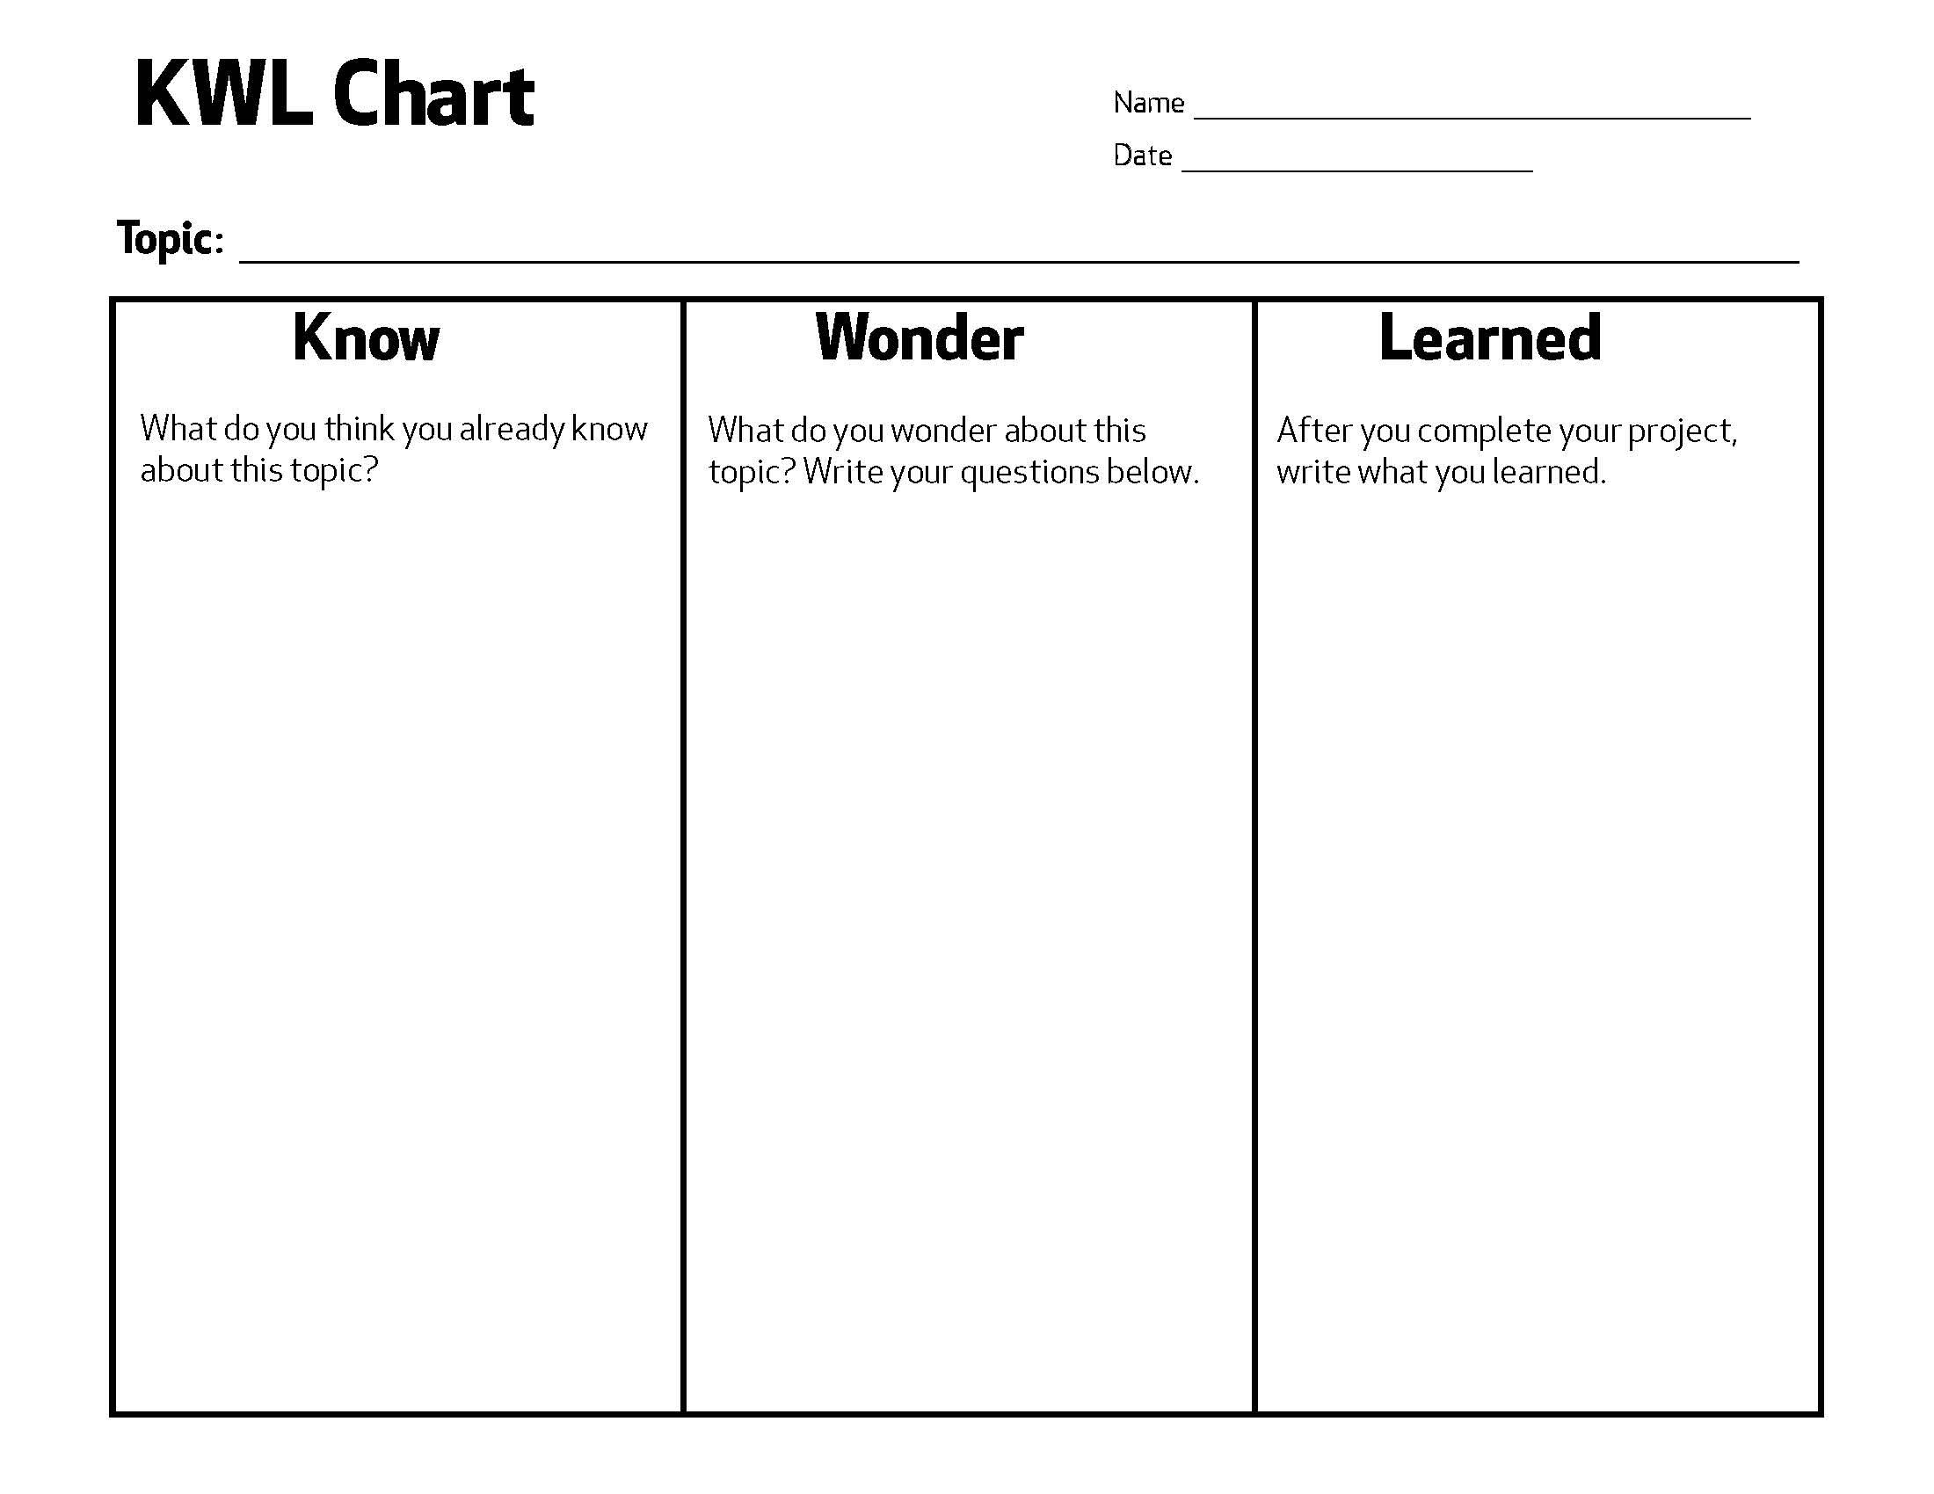
Engage
Today we are going to create a KWL chart for ants.
Notes:
On a piece of chart paper, create a KWL Chart..

Slide 5
Engage
What do you know about ants?
Notes:
Ask students what do you know about ants. Record their answers.

Slide 6
Engage
What do you wonder about ants?
Notes:
What do you want to wonder about ants? Record their answers.

Slide 7
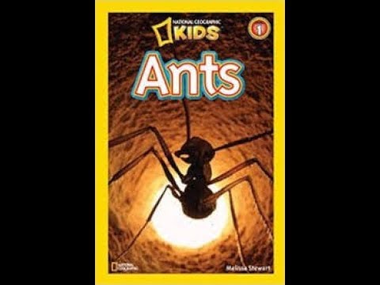
Explore
Listen to the story.
What did you learn about ants?
Notes:
Read (or watch) “Ants by Melissa Stewart.” After reading, the teacher will lead a discussion about the three body parts.

Slide 8
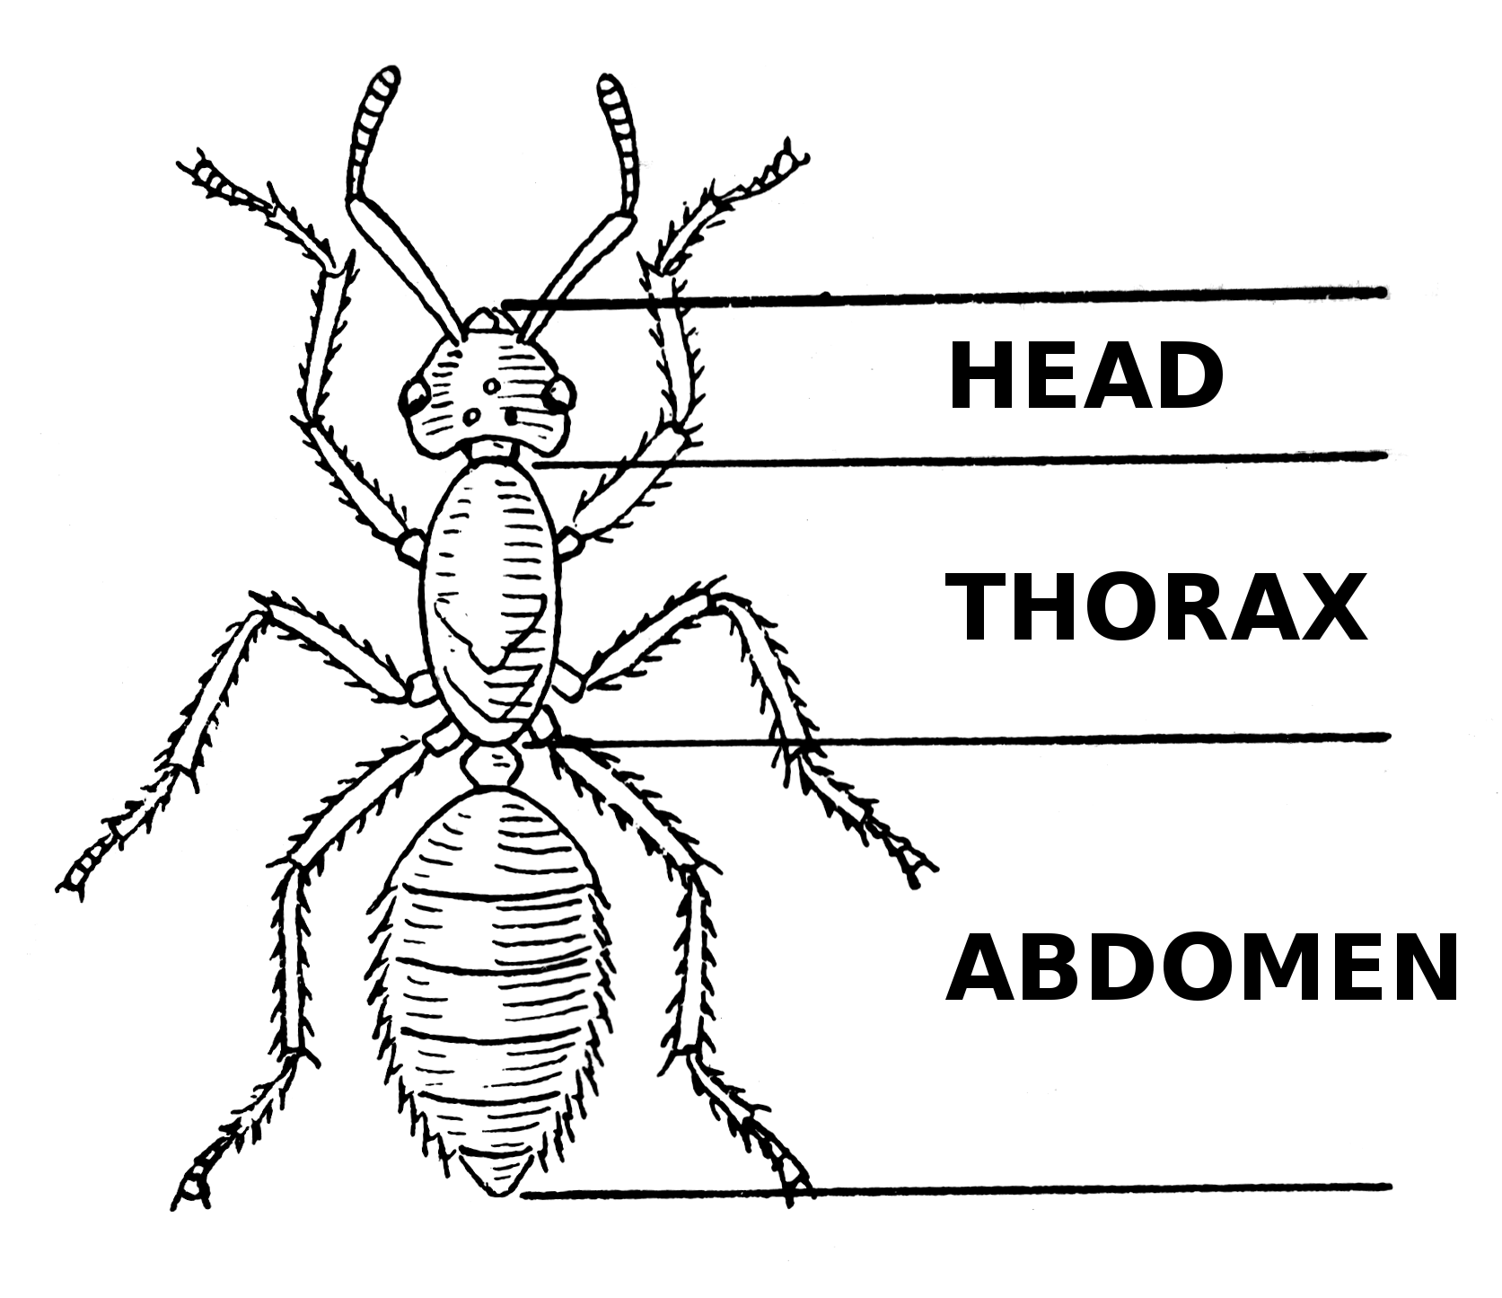
Explore
What is the function of an ant’s head?
Notes:
Ask the students: What is the function of an ant’s head?

Slide 9
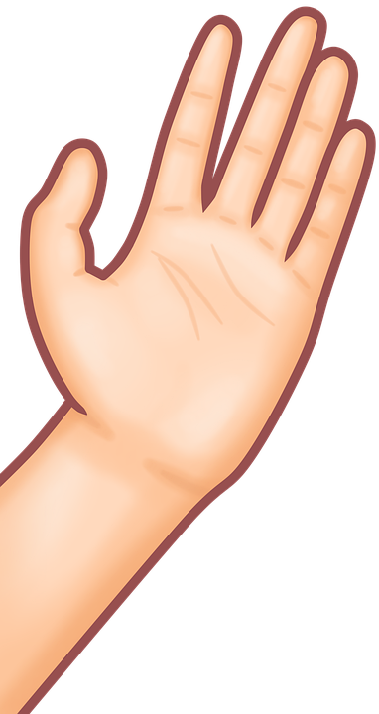
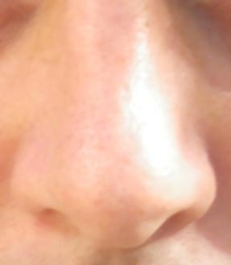
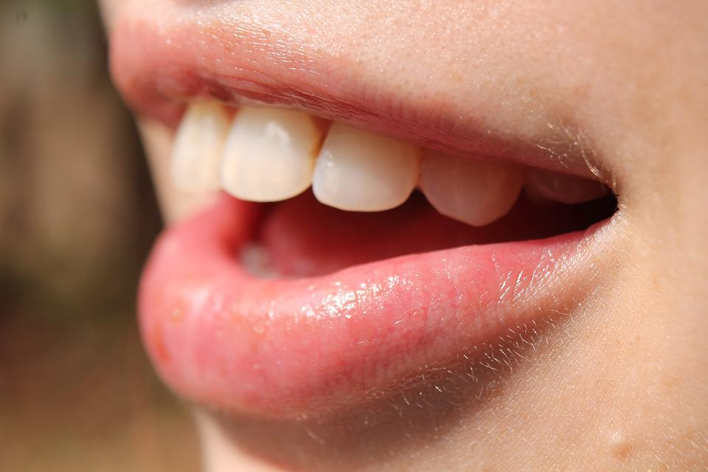
Explore
The head of an ant helps it to touch, smell and taste.
Notes:
Explain to the students the function of an ants head.

Slide 10
Explore
What is the function of an ant’s thorax?
Notes:
Ask the students: What is the function of an ant’s thorax?

Slide 11
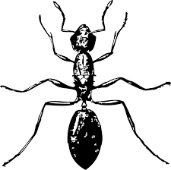
Explore
The thorax is the part of the body where the legs are attached.
Notes:
Explain to the students the function of an ants thorax.

Slide 12
Explore
What is the function of an ant’s abdomen?
Notes:
Ask the students: What is the function of an ant’s abdomen?

Slide 13
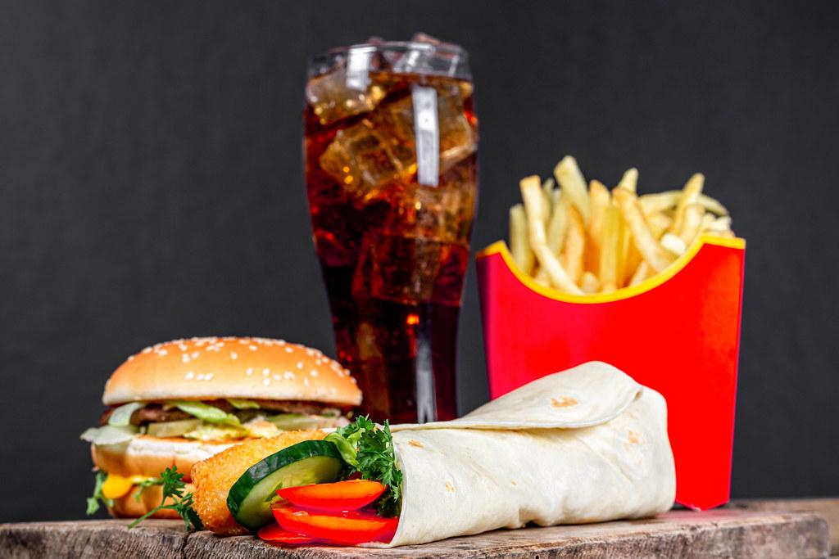
Explore
The abdomen is where the food goes to give its body energy.
Notes:
Explain to the students the function of an ants abdomen.

Slide 14
Explore
What is the function of an ant’s antennae?
Notes:
Ask the students: What is the function of an ant’s antennae?

Slide 15


Explore
The antennae help ants taste, smell and communicate.
Notes:
Explain to the students the function of an ants antennas.

Slide 16
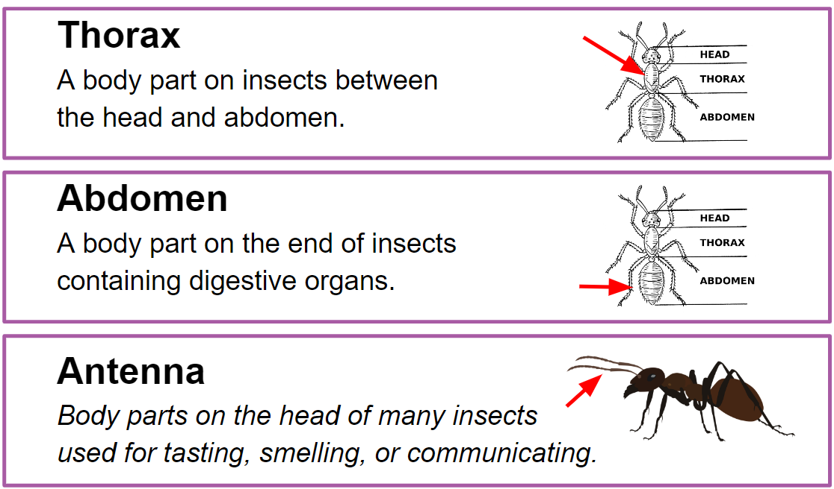

Notes:
Say the word. Have the students repeat the work
Explain the definition
Give an example

Slide 17
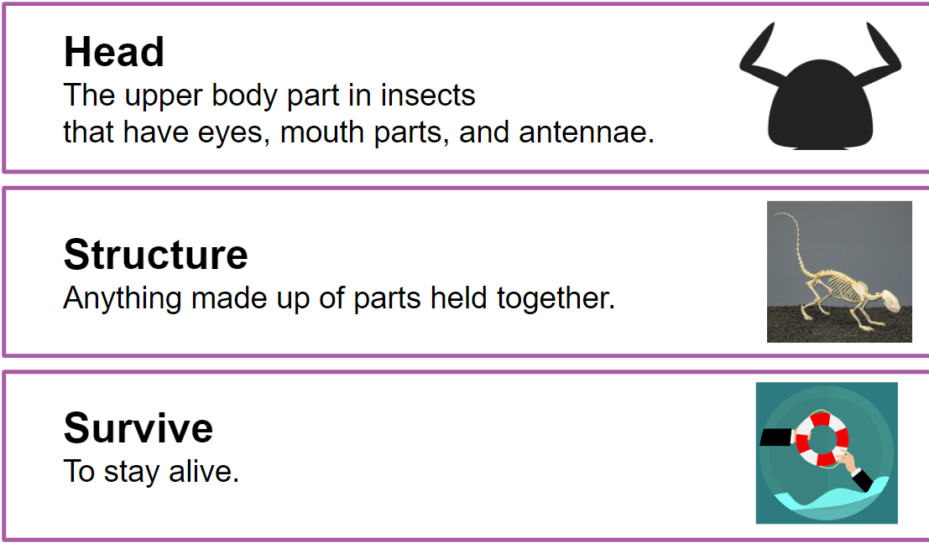
Notes:
Say the word. Have the students repeat the work
Explain the definition
Give an example

Slide 18
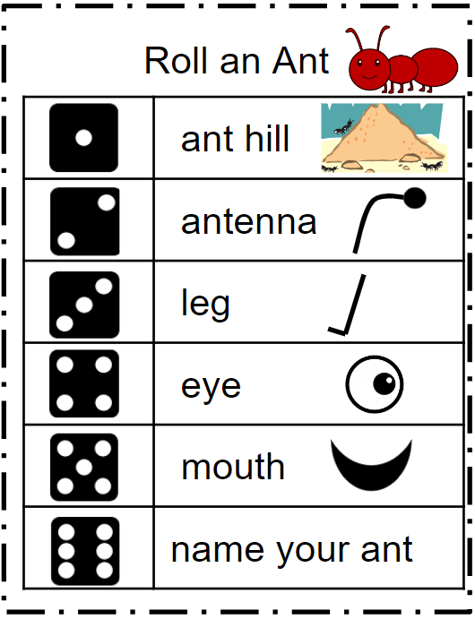
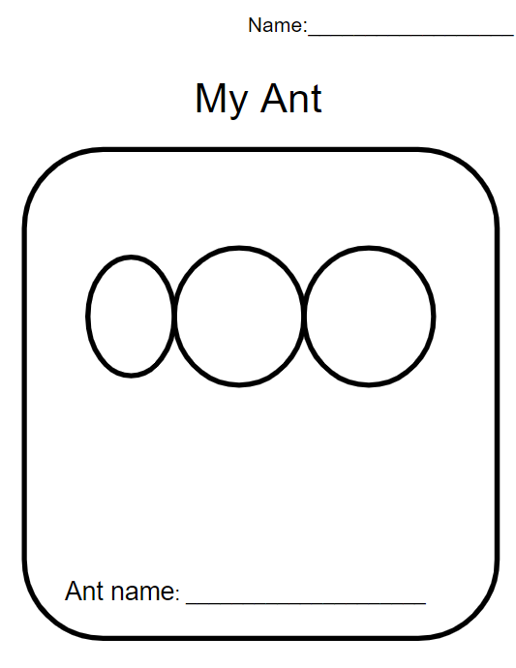
Explore
Students will take turns rolling the dice in a small group or with a partner. Students will draw what body part they have rolled.
Notes:
You will need dice, a pencil, and crayons or colored pencils.

Slide 19

Explain
How does the ant use its body part to survive?
Notes:
Call on three students to share their drawings and explain one body part function. How does the ant use this body part to survive?
Randomly c

Slide 20
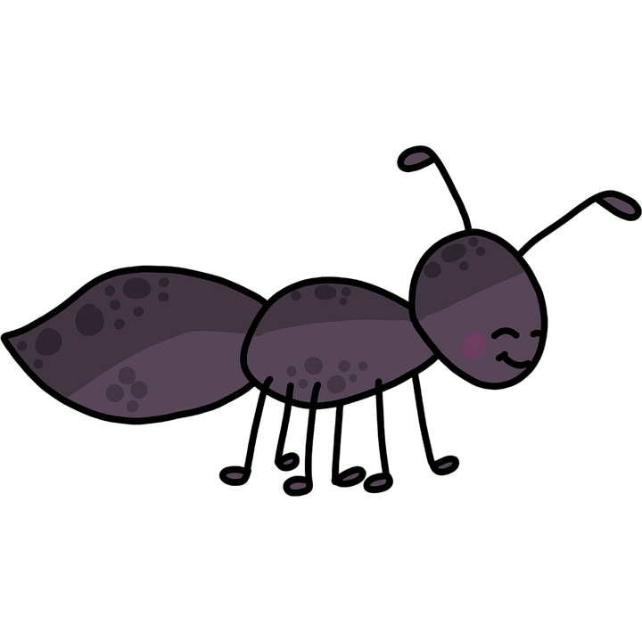
Explain
Let's record our learnings.
What new learning do you have?
Notes:
Revisit the KWL chart to list their learning.

Slide 21

Elaborate
Think of a structure that humans have that helps them to survive.
Let's make a list:
Notes:
Ask students to think of a human structure that helps them survive. Create a list on the board. Students will expand their knowledge that humans have the same three body parts and how these parts help us survive. Students will create a flip book.

Slide 22
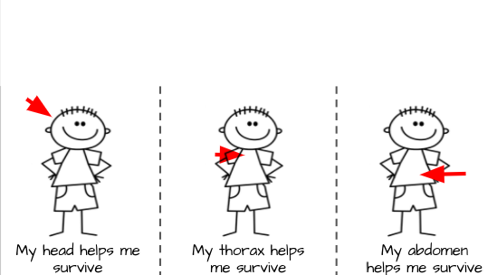

Elaborate
Look at the pictures and think, how do these body parts help me survive? Cut and glue the pictures that show how these body parts help you survive.

Slide 23
Evaluate
Plan a model:
Look at all the various materials, think
What materials can I use to make my three body parts?
What materials can I use to make your antennas?
What other body parts does my ant need?

Slide 24
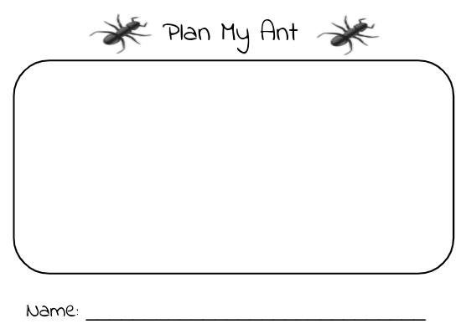
Evaluate
Draw your model
Notes:
Students will first plan out how they will construct their ant using the student handout: Plan My Ant. Show the students examples of materials for students to choose from: play-doh, empty toilet paper rolls, pipe cleaners, coffee filters, pompoms, beads, buttons, etc. Seeing the materials will allow students to plan accordingly.

Slide 25

Evaluate
Create the model that you have drawn using the different materials.
Notes:
Examples of materials for students to choose from: play-doh, empty toilet paper rolls, pipe cleaners, coffee filters, pompoms, beads, buttons, etc.
You can set items up and allow students to choose from a wide range of materials or teacher can pick items for students.

Slide 26

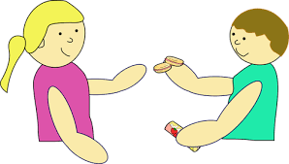
Evaluate
Time to share
Please share with a partner: How you made your ant and how each part
helps it survive.
Notes:
Students will share with a partner how they constructed their ant and how each part helps it survive. Teacher will call on students to share with whole class.

